Slide 3
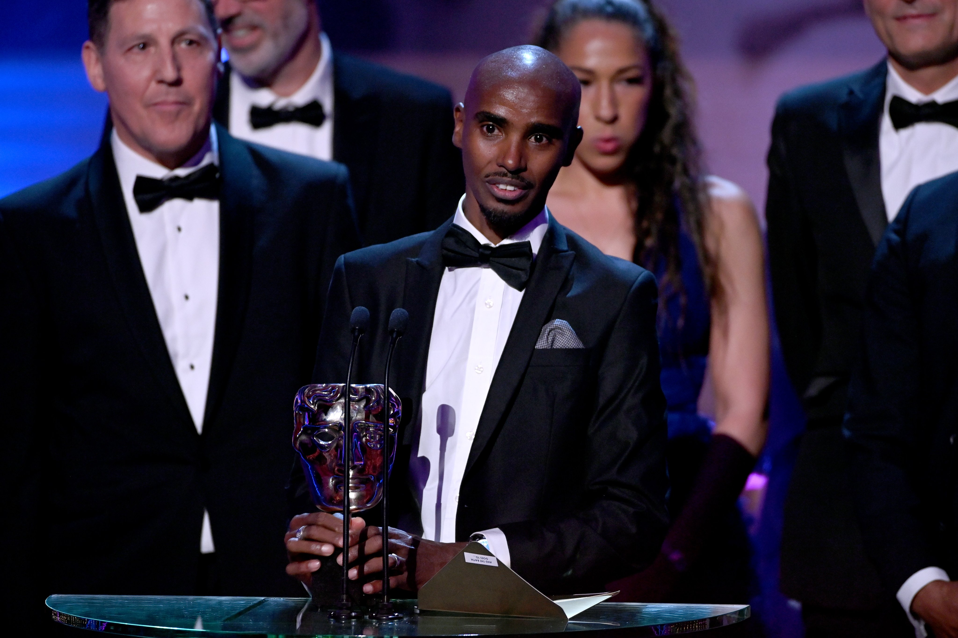



ATOMIZED STUDIOS
OUR STORY
Atomized Studios is an award-winning production company creating impactful, original content for influential leaders, organizations, and brands. We excel in powerful storytelling and creative distinction, bringing stories to life through film, podcasts, interactive digital content and more.
ACCOLADES
Our work has earned prestigious awards, including BAFTA, Rose d'Or, Grierson, Broadcast Award, BPG, and Cannes Dolphins. We produce content that cuts through the noise, from scroll-stopping social videos to high-impact ads, using the latest technology to create immersive and engaging experiences.
3

Slide 4
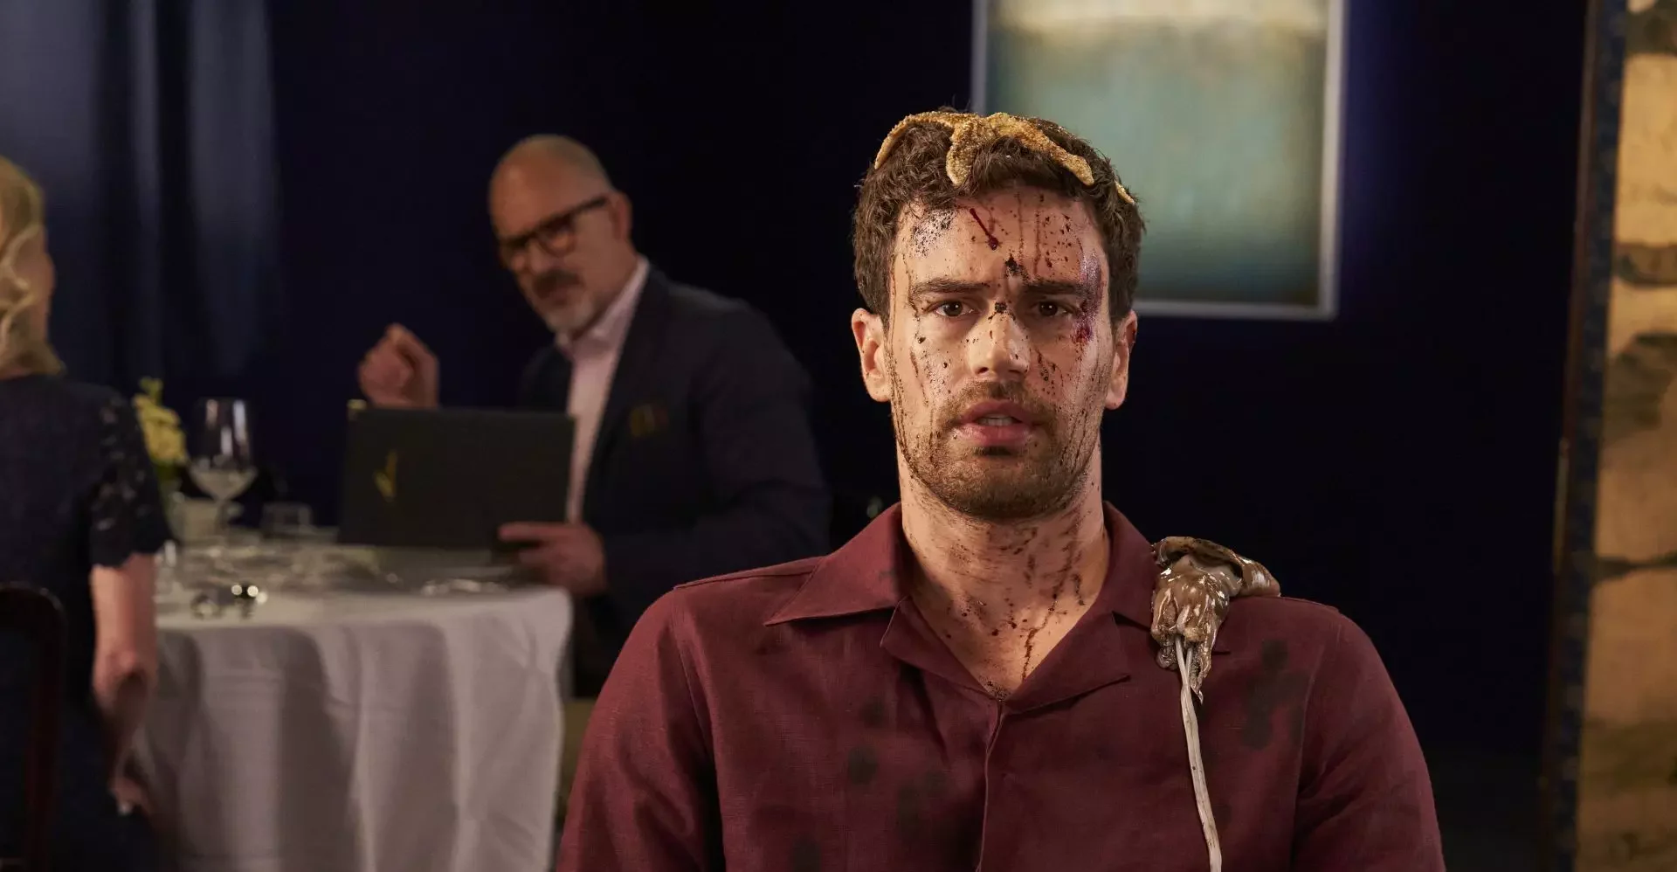
OUR CREDS
4

Slide 5
CONFIDENTIALITY NOTICE
This document and the information contained within (the “Material”) are confidential and/or proprietary and provided for the sole purpose of discussing the potential provision of services by Atomized Studios to the receiver.
This material may not be disclosed to any third party or used for any other purpose (which includes reproduction or transmission of all or part of the work, whether by photocopying or storing in any medium by electronic means or otherwise) without the express written permission of Atomized Studios.
STRICTLY CONFIDENTIAL
©2025 freuds. All rights reserved

